Slide 1

PAPER REVIEW TASK 1
Federated Learning
in Medical Imaging
Review of Advancements and challenges of federated learning in medical imaging: a systematic literature review
Submitted by
Abdul Khaled Arafat | ID: 2671507
Institute of Information and Communication Technology
Khulna University of Engineering and Technology
Submitted to: Dr. M. A. Moyeen
Assistant Professor,
Institute of Information and Communication Technology
Khulna University of Engineering and Technology

Slide 2
Paper at a Glance
2026
537
123
Systematic review
Initial records screened
Included studies
Chosen paper
Ghosh et al. review how federated learning supports collaborative cancer imaging AI while keeping patient images inside each hospital.
Review paper from Springer / Artificial Intelligence Review
Focus: AI/ML in healthcare, privacy-aware medical imaging
Covers skin, lung, colorectal, brain, and breast cancer imaging
Directly fits the assignment themes: trends, gaps, security, privacy
02

Slide 3
Problem Statement: Data Is Fragmented
Core barrier
Hospitals hold image data
What FL promises
MRI, CT, mammography, dermoscopy, histopathology
Different scanners, protocols, patient groups, labels
Privacy rules and institutional ownership block easy pooling
Deep learning needs large, diverse datasets, but cancer images are usually locked inside separate institutions.
Train locally at each hospital
Share model updates, not raw images
Aggregate a global model for cross-site learning
Reduce data-sharing risk, but not every risk
Big message: FL is a privacy-aware collaboration method, not a magic privacy solution
03

Slide 4
How Federated Learning Works
1
Local training
Each hospital trains on its own images.
2
Update sharing
Only parameters/gradients are sent.
3
Secure aggregation
Server combines client updates.
4
Global model
The improved model returns to hospitals.
5
Repeat
Rounds continue until performance stabilizes.
1
04

Slide 5
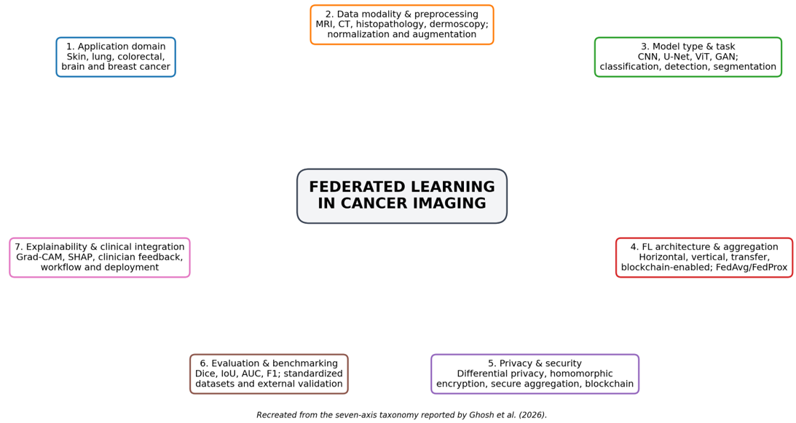
Seven-Axis Taxonomy
The taxonomy moves beyond accuracy: it links application domain, data modality, model type, FL setup, privacy, evaluation, and clinical integration.
05

Slide 6
Applications Across Five Cancer Domains
Skin
ISIC-2019, HAM10000; CNN/SVM, InceptionV3, fairness-aware personalization
Dermoscopy
Lung
CapsNet, DenseNet, attention CNNs, U-Net, GANs, lightweight CNNs
CT / X-ray
Colorectal
ResNeXt, VGG/BiT, style transfer, FedDropoutAvg, encrypted FL
Histopathology
Brain
U-Net, 3D U-Net, VGG16, DenseNet, personalized FL; BraTS benchmark
MRI
Breast
YOLO, ResNet, U-Net, MobileNet, autoencoders, differential privacy
Mammo / US / pathology
06

Slide 7
Repeated Methodological Trends
1
2
3
4
5
CNN
families
U-Net /
3D U-Net
ResNet /
DenseNet
MobileNet /
EfficientNet
FedAvg →
FedProx/FedBN
Classification baseline
Segmentation backbone
Deep feature extraction
Resource-limited clients
Non-IID & stability
Preprocessing is modality-dependent
Accuracy alone is insufficient
MRI: skull stripping + intensity normalization
CT: denoising + lesion/nodule segmentation
Histopathology: stain normalization + tile selection
Dermoscopy: resizing, normalization, augmentation
Report Dice/IoU for segmentation
Use sensitivity, F1, AUC for imbalance
Also include latency, energy, privacy budget, external validation
07

Slide 8
Representative Study Comparison
Study | Cancer/data | FL model/task | Reported result | Privacy/security | Main limitation
Yaqoob et al. 2023 | Skin; ISIC-2019 | Async-FL-CNN classification | F1 94.8% | Raw data local | Resource heterogeneity not evaluated
Heidari et al. 2023 | Lung; CT datasets | Federated CapsNet detection | Accuracy 99.69% | Blockchain-enabled FL | Annotation and deployment overhead
Truhn et al. 2024 | Colorectal cohorts | Encrypted FL image analysis | Dice 78.5–86.8% | Homomorphic encryption | Limited network setting assumptions
Kumar et al. 2024 | Brain; BraTS MRI | 3D U-Net segmentation | Accuracy 88.60% | Blockchain + privacy FL | Latency and heterogeneous clients
Gupta et al. 2025 | Breast; BreakHis/BUSI | YOLOv6 ensemble FL | Accuracy 97–98% | Raw data local | Only simulated clients; limited deployment metrics
Takeaway: many papers report high accuracy, but privacy layers, client heterogeneity, latency, and clinical validation are still unevenly reported.
08

Slide 9
Security & Privacy Analysis
Main risks
Gradient / parameter leakage
Model-inversion and membership-inference attacks
Poisoned local updates from malicious clients
Weak client authentication and poor update provenance
Best-practice protection stack
Secure aggregation + lightweight encryption
Differential privacy where acceptable
Client authentication and audit logs
Anomaly detection for suspicious updates
Report privacy–accuracy–latency trade-offs
No single privacy method solves all risks; secure medical FL needs layered protection and evaluation.
09

Slide 10
UNSOLVED RESEARCH GAPS
Open Challenges Identified by the Authors
Non-IID data & domain shift
Privacy–security trade-offs
Different scanners, staining, demographics, disease prevalence, and labels.
DP, encryption, and secure aggregation add noise, computation, bandwidth, and latency.
Class imbalance & scarce labels
Aggregation instability
Rare malignant cases and expert annotation shortage reduce model reliability.
FedAvg struggles with client drift, unreliable clients, and hardware disparity.
Heavy models & communication cost
Clinical workflow gap
3D U-Net, GAN, YOLO, and transformer systems can exceed small-site resources.
Few studies integrate with PACS/EHR, governance, regulation, or continuous monitoring.
The biggest gap is not only algorithm accuracy; it is trustworthy, scalable, clinically validated deployment.
10

Slide 11
Critical Analysis & Future Directions
My critical view
Recommended next steps
The review is strong because it connects technical FL design with clinical readiness.
However, many primary studies are simulation-heavy and do not prove hospital deployment.
Accuracy is often emphasized more than privacy budget, latency, fairness, calibration, or prospective validation.
The review could discuss regulation, consent, accountability, and clinician adoption more deeply.
Prospective multi-hospital validation on real clinical workflows.
Explainable federated AI using Grad-CAM, SHAP, and explanation-consistency checks.
Federated transfer/meta-learning for rare cancers and small datasets.
Communication-efficient FL with compression, distillation, and edge–cloud coordination.
Standard reporting: accuracy + privacy + latency + compute + fairness + external validity.
Conclusion: federated learning is a promising path for collaborative cancer imaging AI, but clinical value depends on robust privacy, generalization, explainability, and deployment evidence.
t.
11

Slide 12
Thank You
Questions?

